Slide 1
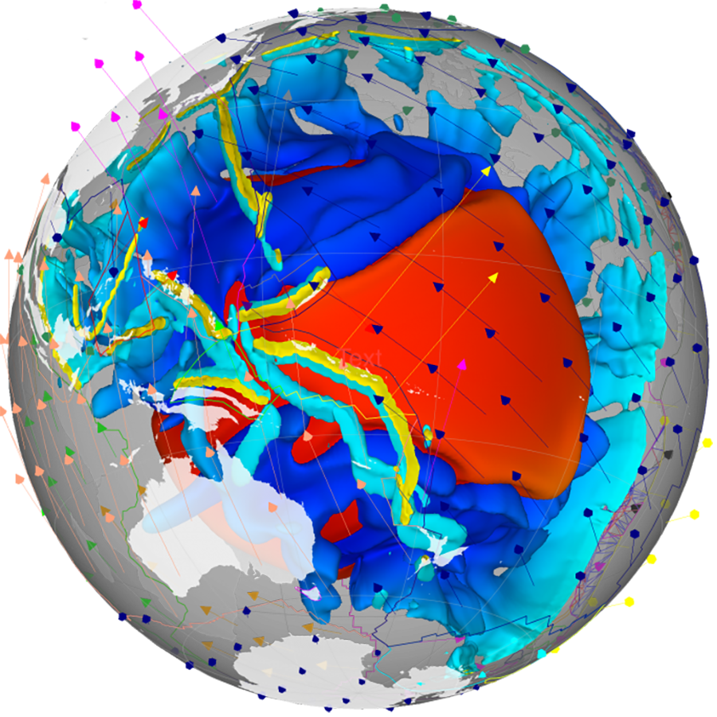

GPlates
Deep Time Palaeogeography in R
Elizabeth M. Dowding
Ádám T. Kocsis
2024

Slide 2
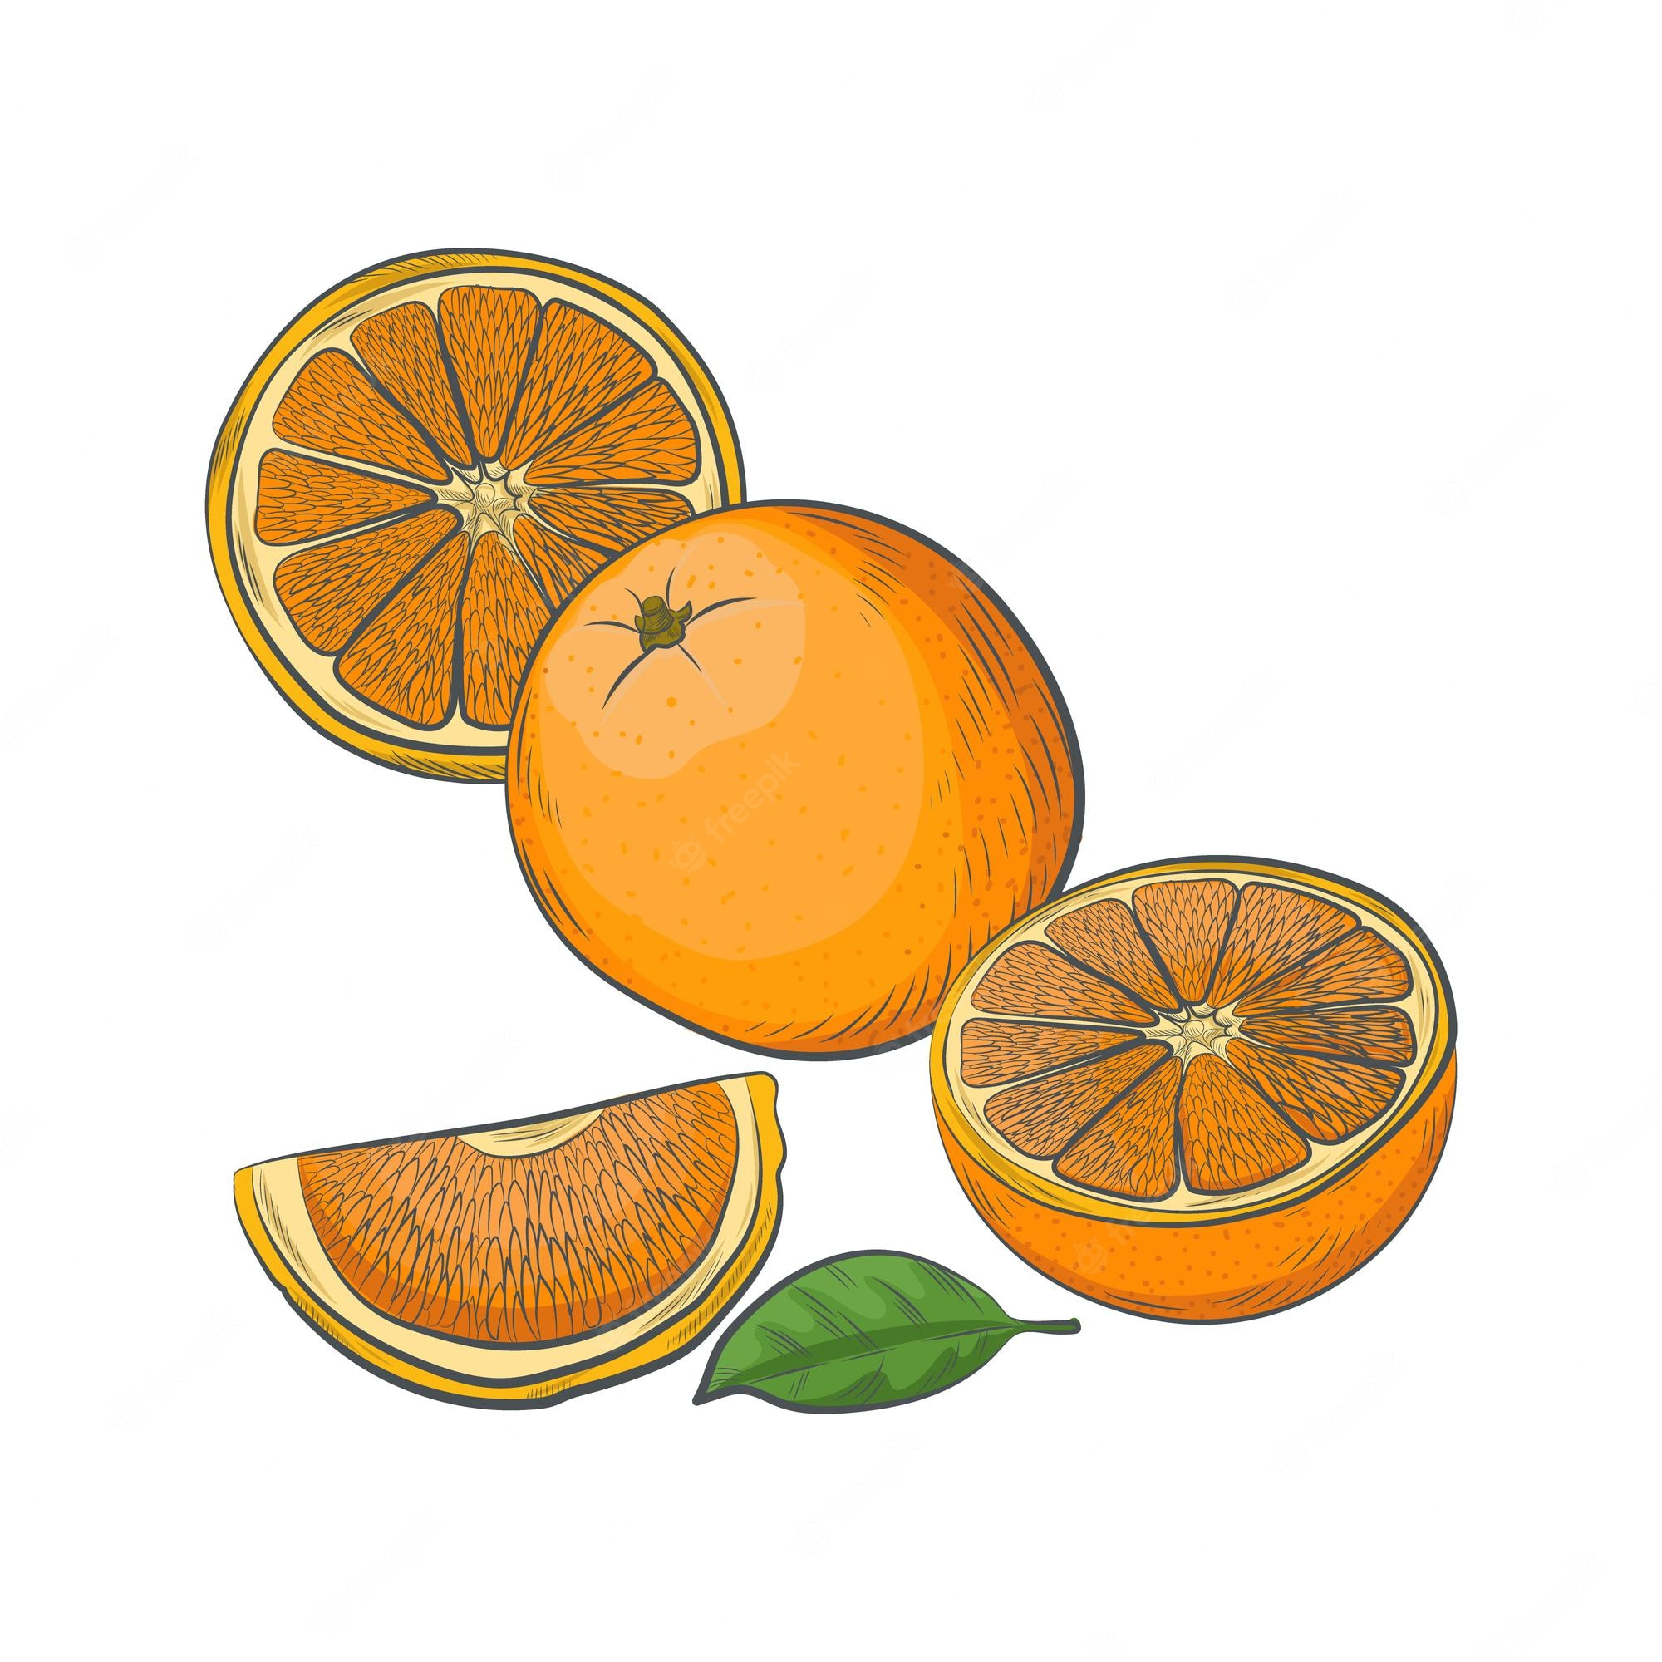
Contents
Introduction to Plate Models
Using models in R
Plotting point palaeodata
Integrating R libraries and resources

Slide 3
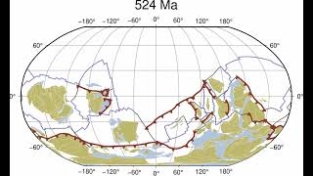
Merdith et al 2021.
Notes:
Full plate reconstruction. Dynamic and animated.
Merdith et al 2021.

Slide 4
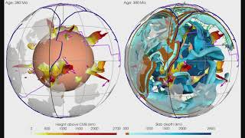
https://youtu.be/swGDLBOCqBg
Notes:
The mantle processes and interaction with the core. There are many layers to GPM development and many questions those interested in earth history are invested in working on.
https://youtu.be/swGDLBOCqBg

Slide 5
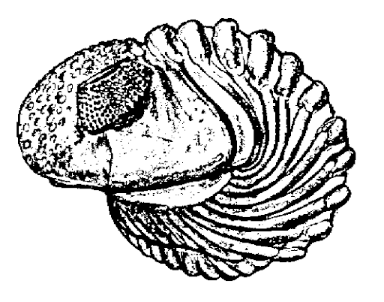
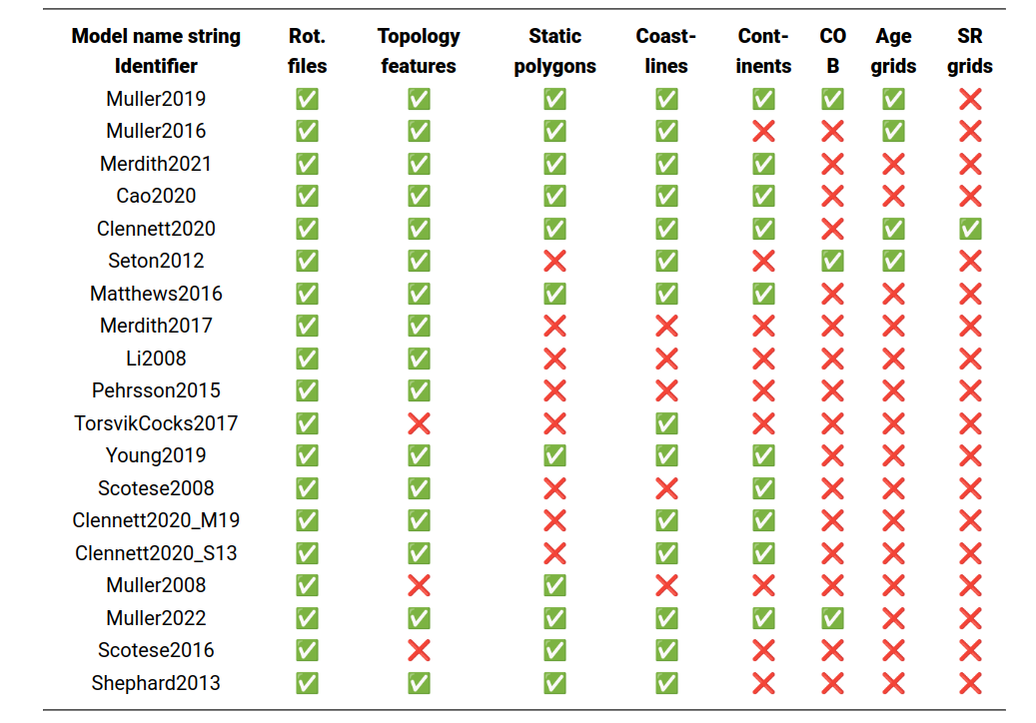
Houston, we have a problem!
Notes:
The mas are extremely variable. There are lots of reason why.

Slide 6
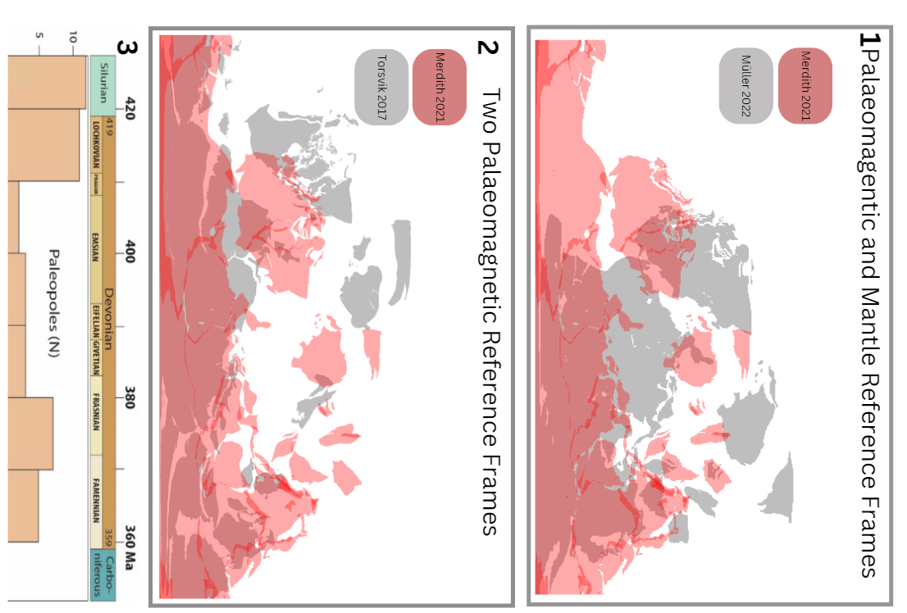
Houston, we have a problem!
Devonian 400Ma
Notes:
The mas are extremely variable. There are lots of reason why.

Slide 7
Houston, we have a problem!
Notes:
One of them is data availability.

Slide 8
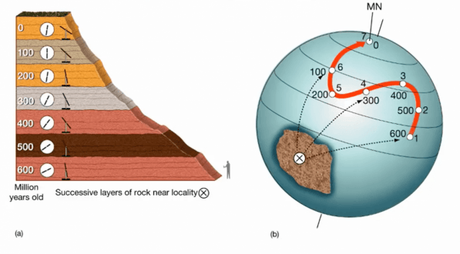
Apparent Polar Wander
Notes:
From Palaeopoles we get relative motions. They are made in relation to GAD, the Geocentric Axial Dipole.

Slide 9
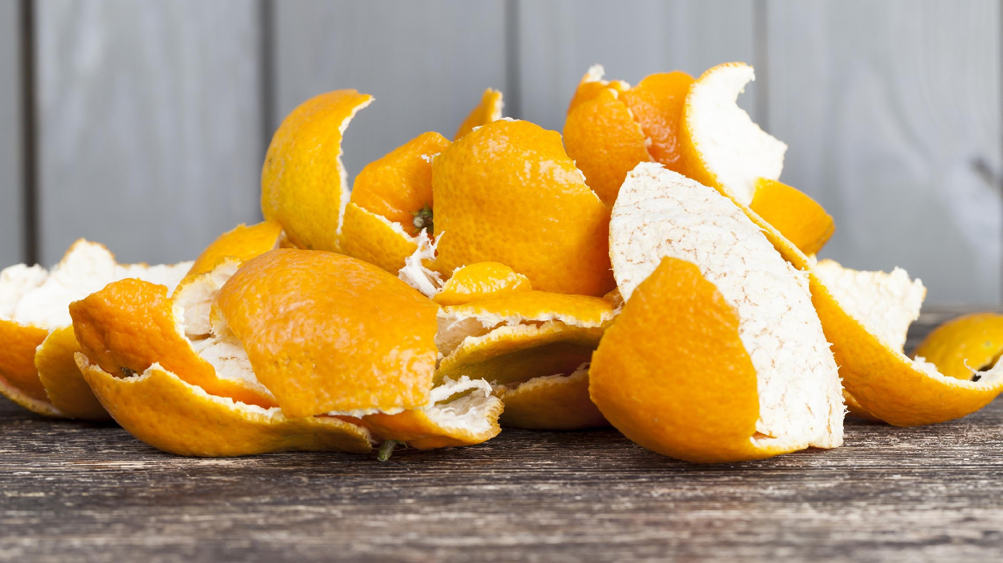
Palaeomagentic Reference Frame

Slide 10
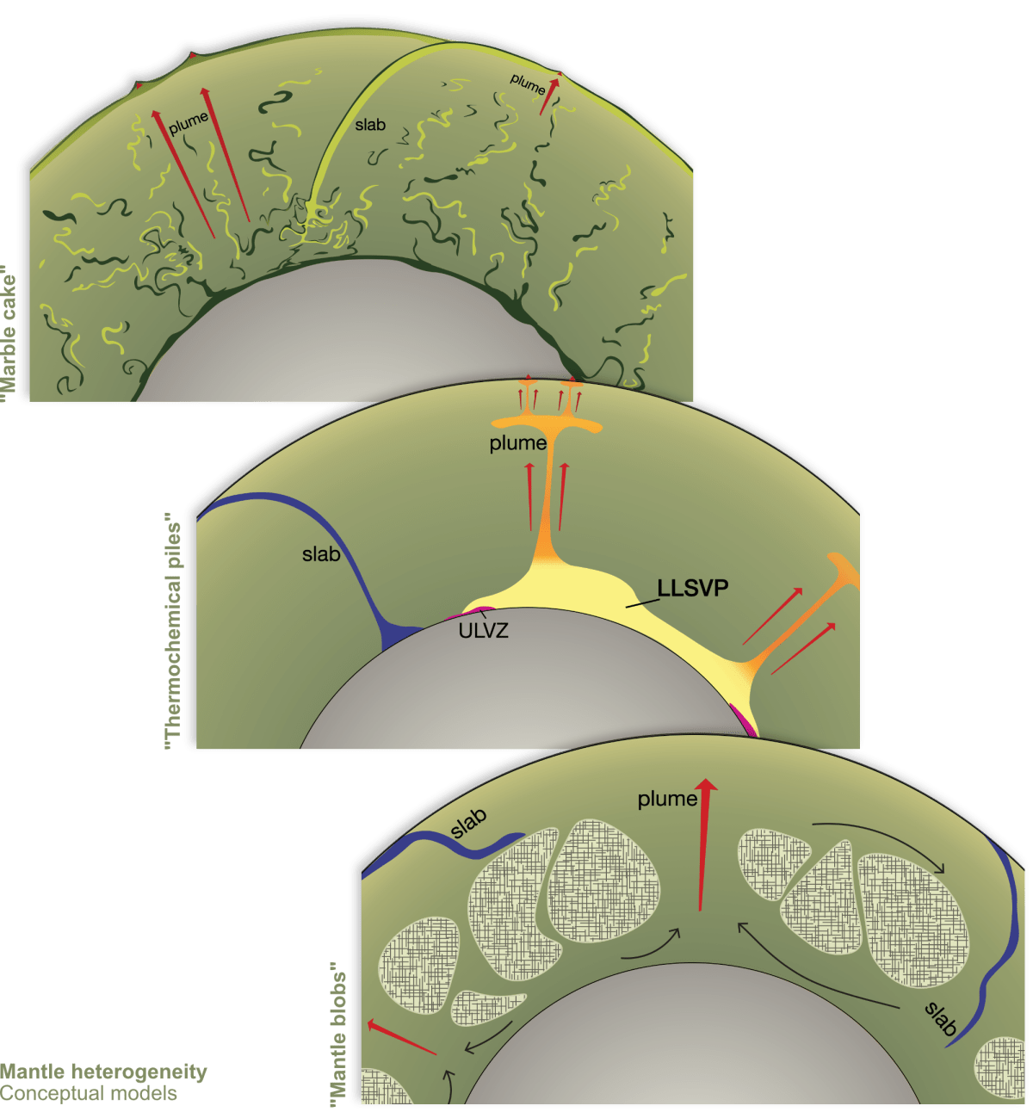
Mantle heterogeneity theories
Notes:
Another is the impact of mantle theories on surface expression.

Slide 11
Notes:
Palaeomag does not centre mantle features (the mantle reference frame does) but it does interact with them. EG LLSVPs are a contentious feature of some maps and some interpretations.

Slide 12
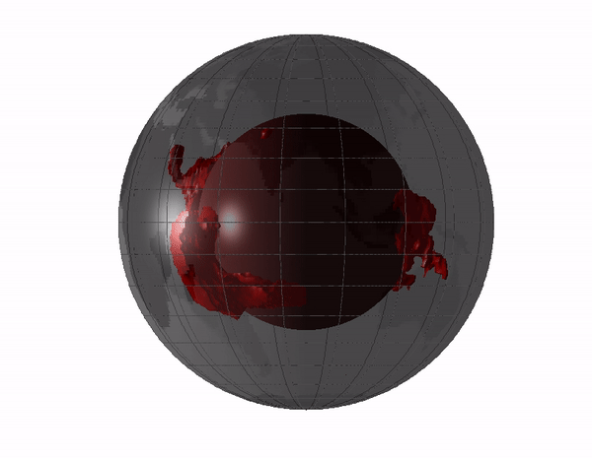
Notes:
Jason and Tuzo. Antipodal and equatorial.

Slide 13
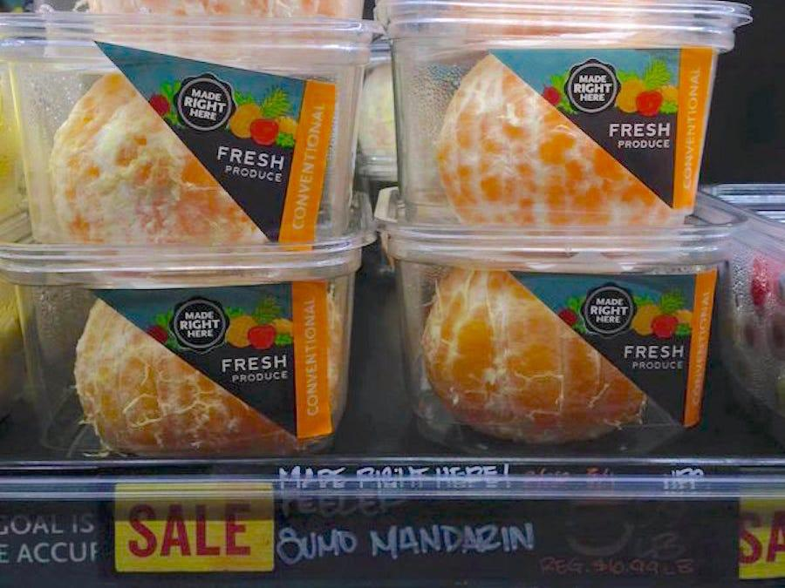
Mantle Reference Frame

Slide 14

Earth is a spinning ball in space
Notes:
This leads to different useages of features of the planet. The palaeomagnetic data and the Mantle feature focus

Slide 15
Mantle RF and Palaeomag RF
Notes:
A quick way of understanding the difference in conception is this. But why do I want you to use PMRF?

Slide 16
Mantle RF and Palaeomag RF
Notes:
A quick way of understanding the difference in conception is this

Slide 17
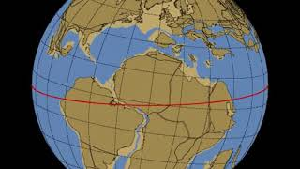
True Polar Wander and GPMs
https://youtu.be/UEEFlmxVh94
Notes:
This is why. Only palaeomagnetic data captures it.
But there are real impacts for palaeontologists. There is currently only one reference frame we can use for deep time and I shall tell you why. TPW.
https://youtu.be/UEEFlmxVh94
Break. ☺

Slide 18
Apparent Polar Wander? True Polar Wander?
Notes:
APW is earth relative.
TPW corrected for earths situation in the cosmos

Slide 19
Apparent Polar Wander? True Polar Wander?

Slide 20
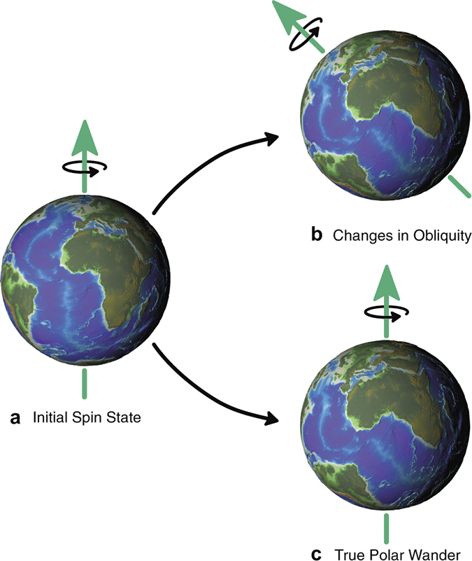
Apparent Polar Wander? True Polar Wander?

Slide 21
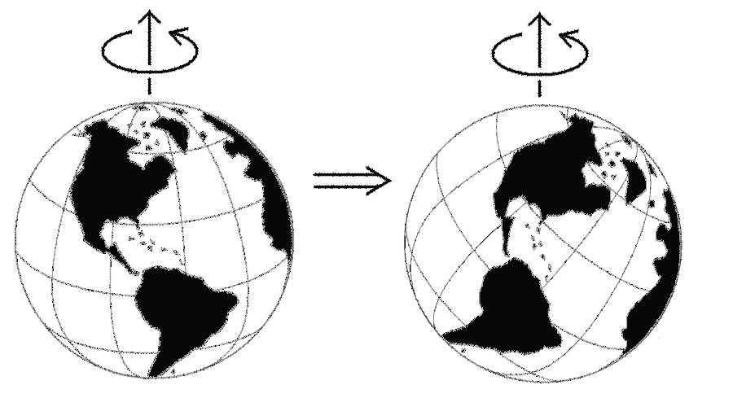
True Polar Wander: consider reconstruction
Notes:
The arrangement is the same. The latitudes are very different.

Slide 22
True Polar Wander
Movement of the entire lithosphere with respect to the mantle or of the mantle relative to the core.
Notes:
Comparison of plate motions assuming a fixed hotspot framework indicates that TPW has amounted to about 12° since the Early Tertiary. Because TPW affects equally all calculated poles of a given age in the same way, however, it does not usually influence relative plate motions deduced from APW paths.

Slide 23
True Polar Wander
Formal definition:
As defined as the migration of the maximum moment of inertia (I_{max}) to. align with Earth’s spin axis, TPW occurs as a rotation about an Euler pole controlled by the minimum moment of inertia (I_{min}) that is equatorial and is therefore predicted to circumscribe a great-circle APW path
Notes:
Comparison of plate motions assuming a fixed hotspot framework indicates that TPW has amounted to about 12° since the Early Tertiary. Because TPW affects equally all calculated poles of a given age in the same way, however, it does not usually influence relative plate motions deduced from APW paths.

Slide 24
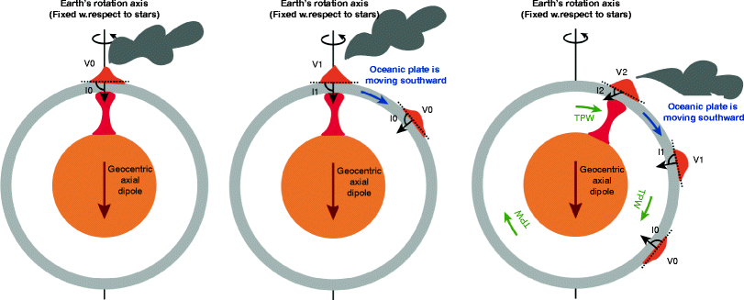
In GAD we trust

Slide 25
Mantle RF and Palaeomag RF

Slide 26
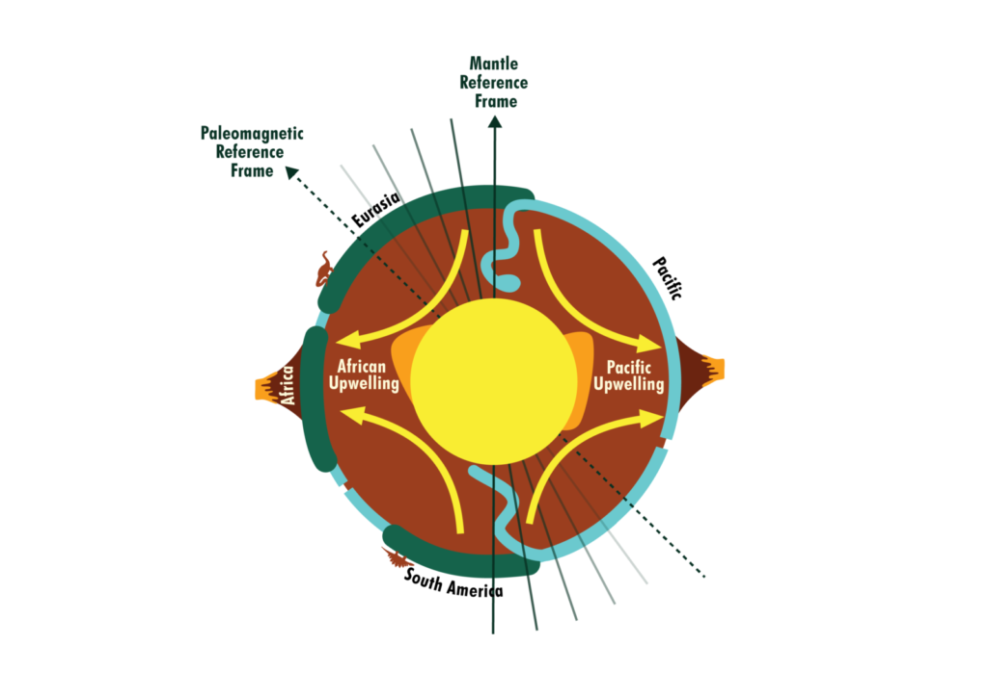
The PMRF has problems
The MRF has problems
Notes:
Mantle reference frames use mantle features such as upwellings and subducted slabs as an absolute reference to plate motion. These reference frames do not always reflect the true position of past continents as they neglect true polar wander. This is shown in the figure with the implied spin axis of the Earth in a mantle frame actually in a different place in the paleomagnetic frame due to a shifting of the plate-mantle system relative to the core. Image by Rachel O’Brien and based on Conrad et al, 2013.

Slide 27
The way you think about a problem will ALWAYS impact the product.

Slide 28
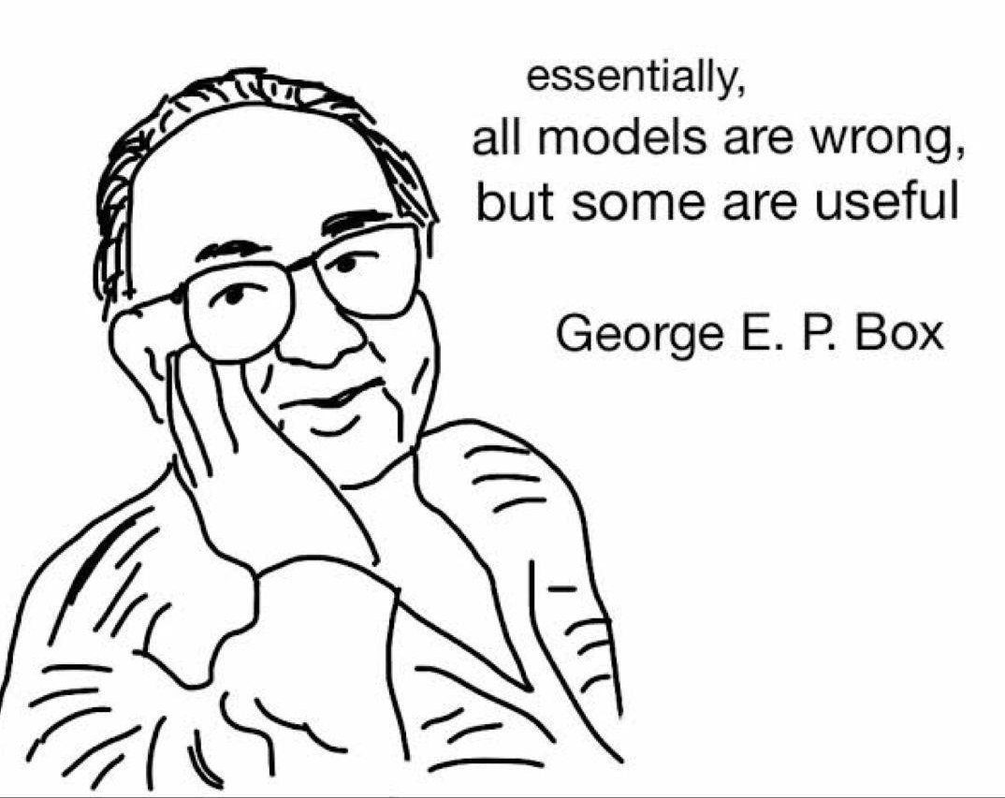
But from them we have learnt:
The role of isolation in speciation
Requirements for endemism and biodiversity hotspots
Latitudinal diversity gradients
The regional patterns in selectivity and resistivity regarding extinction
Notes:
Not hopeless! Lets get going!

Slide 29

R tutorial:
Download resources from Github
Navigate to: ‘code\1_explore.R’
https://tinyurl.com/palaeogeography2024palass

Slide 30
R tutorial:
Download resources from Github
Navigate to: ‘code\1_explore.R’
Coastlines vs static polygons

Slide 31
Break

Slide 32

GPM Developers and Users
The Two Towers

Slide 33
Types of Age
Relative time (“chronostratic”) – subdivisions of the Earth’s geology in a specific order based upon relative age relationships (most commonly, vertical/stratigraphic position). These subdivisions are given names, most of which can be recognized globally, usually on the basis of fossils.
Absolute time (“chronometric”) – numerical ages in “millions of years” or some other measurement. These are most commonly obtained via radiometric dating methods performed on appropriate rock types.
Notes:
Many of use are comfortable with multiple types of age. Some of us may even work within regional chronostratigraphy over the international one. On this the developers and us agree.

Slide 34
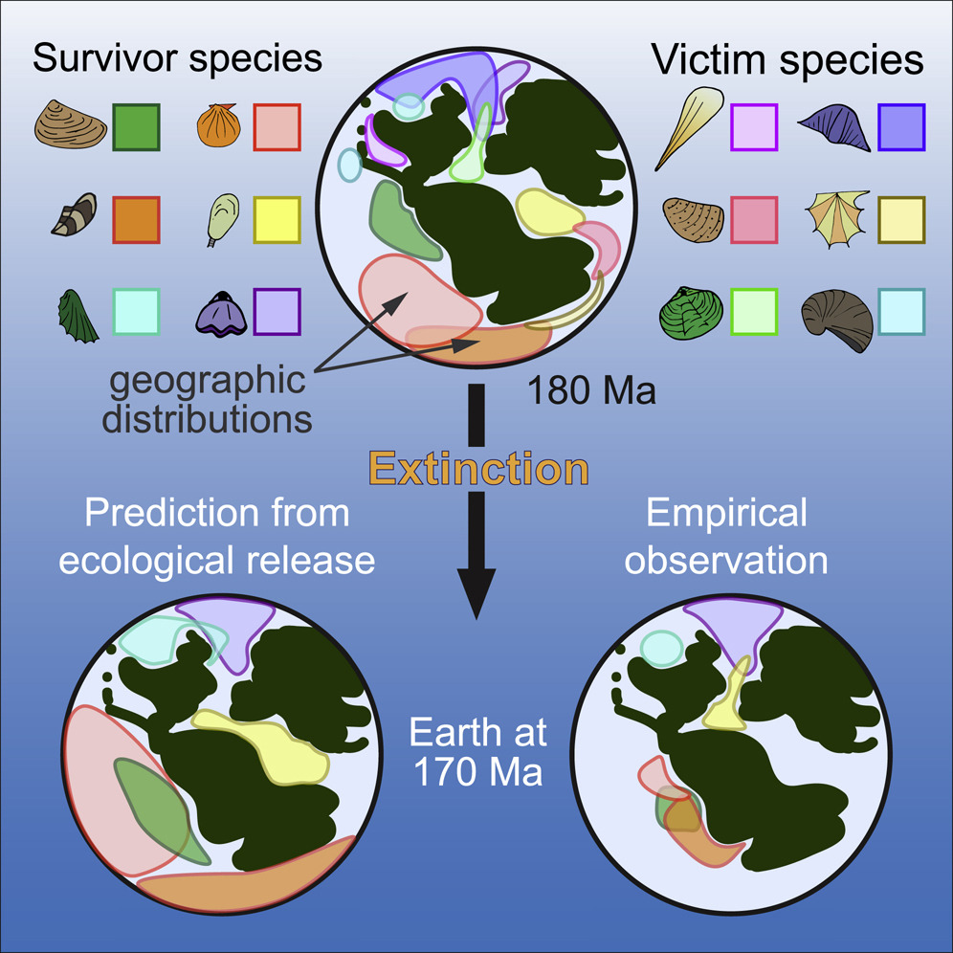

Tower 1: Us
Antell et al 2020
Notes:
We are map users. Our research questions are different to the developers and often are not catered for in the application design (thank you RGplates).
We are used to time averaging. We make many choices about ranges and distribution (temporal and spatial) that impact our process and results. When asking questions about this we need to consider how well our data fits a map and what impact the map itself could have on our results.
Marine Biodiversity and Geographic Distributions Are Independent on Large Scales: Current Biology

Slide 35
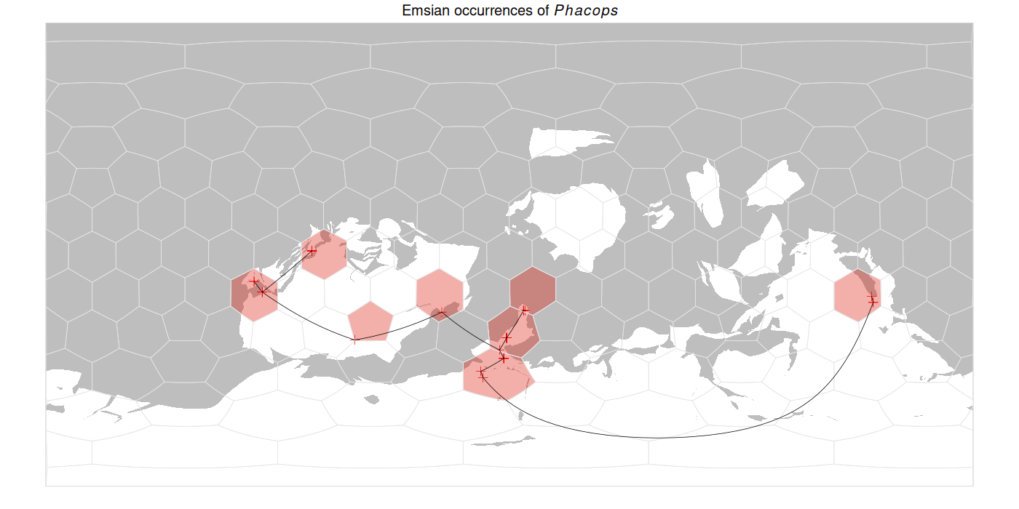
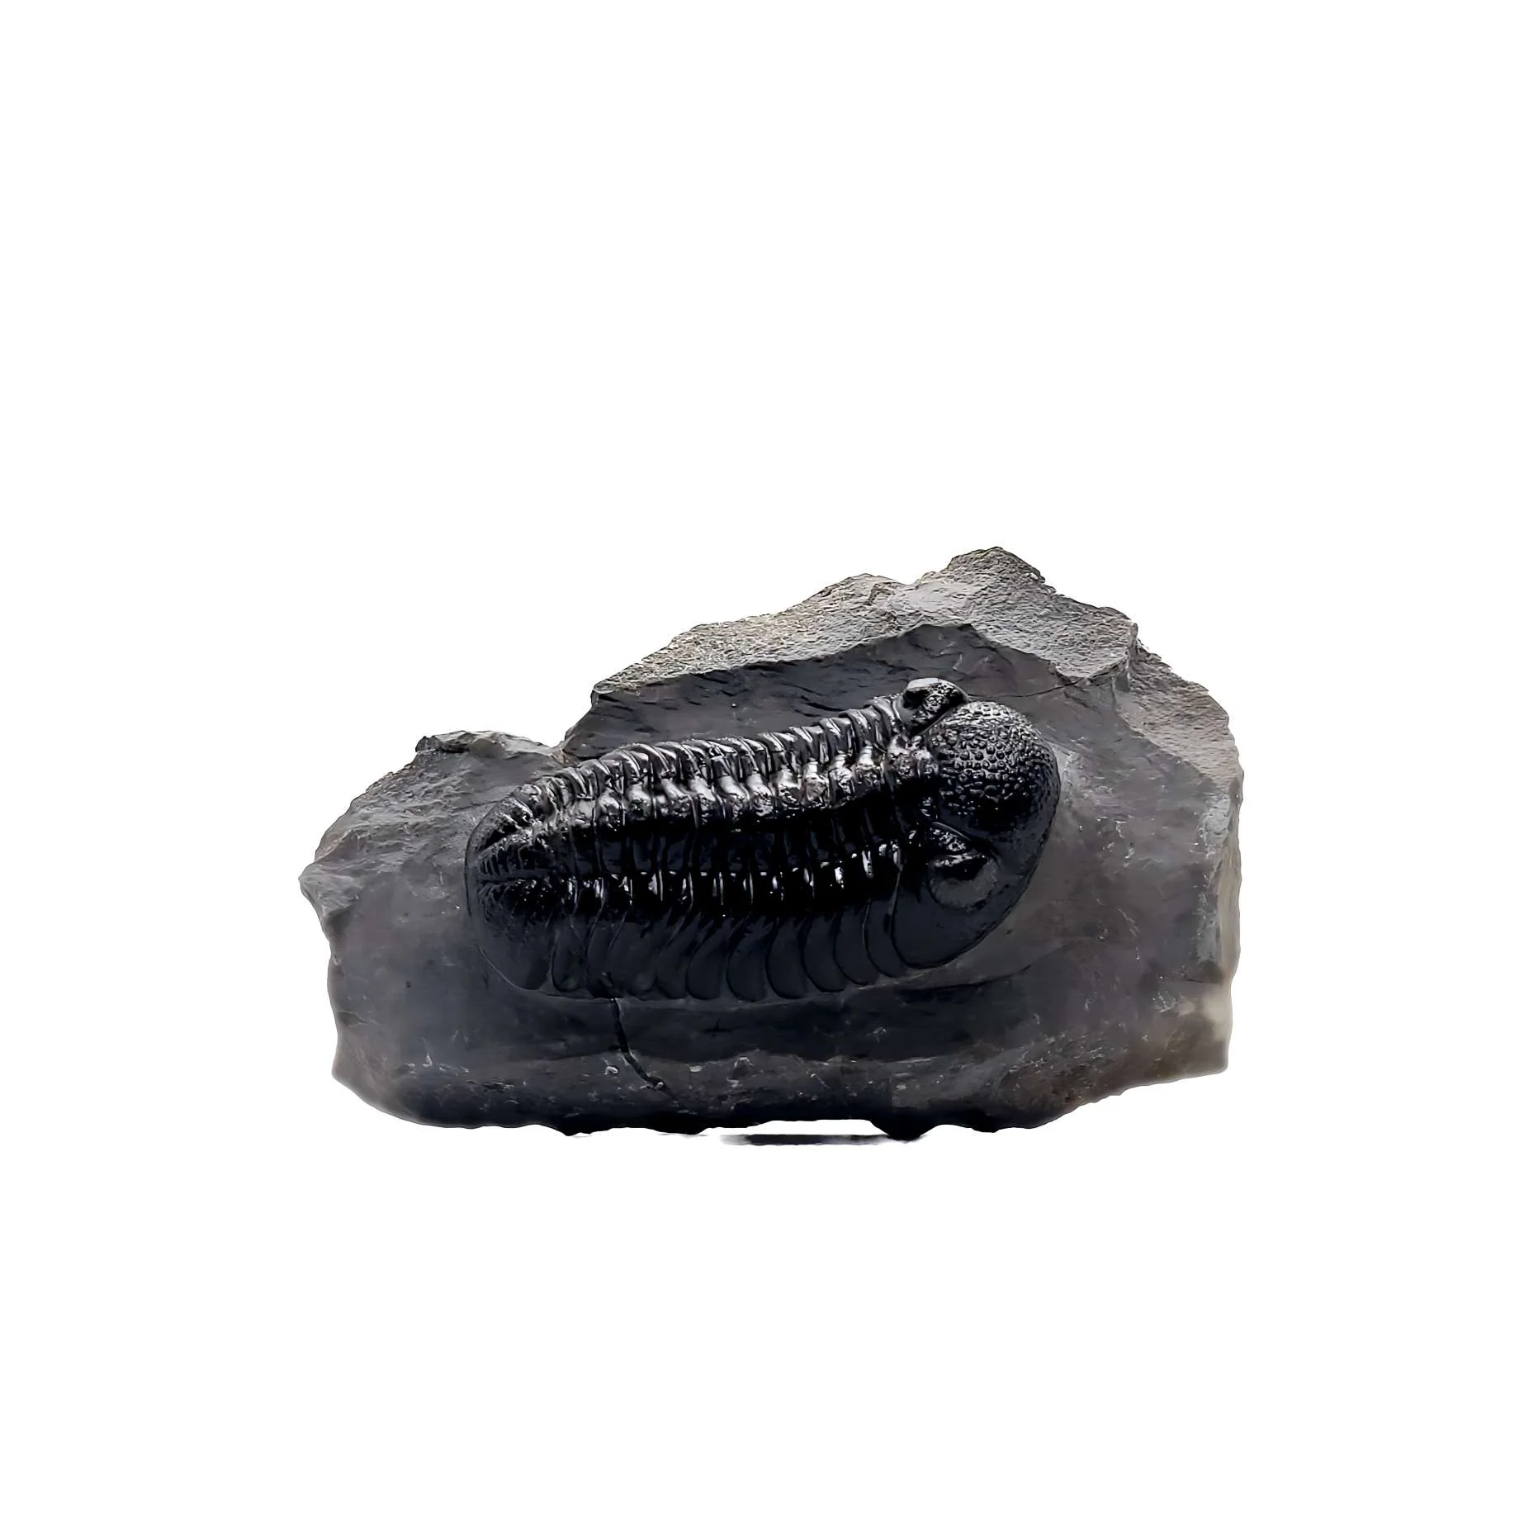
Tower 1: Us
Notes:
We are map users. Our research questions are different to the developers and often are not catered for in the application design (thank you RGplates).
We are used to time averaging. We make many choices about ranges and distribution (temporal and spatial) that impact our process and results. When asking questions about this we need to consider how well our data fits a map and what impact the map itself could have on our results.
Marine Biodiversity and Geographic Distributions Are Independent on Large Scales: Current Biology

Slide 36
Tower 1: Us
Notes:
But the maps are often incompatible. There are often few data. The developers themselves bin their data to create their maps. How we treat binning and and its interaction with plate-duration

Slide 37
Tower 2: Developers
Target age | (numeric) is the target age in Ma at which the feature will be reconstructed. Defaults to 0 Ma
Notes:
There are few data (as we saw) so reconstructed target ages are interpolated and rely on the developers decisions about geophysical, geodynamic, kinematic processes. They do not map every year. Often they map every 5-10 million and the rest are interpolated. The developers provide Gplates for us to use, it is a great resources, but most o the functionality of the program isn’t useful for us and so we must integrated our own resources (thank you RGPlates)/

Slide 38
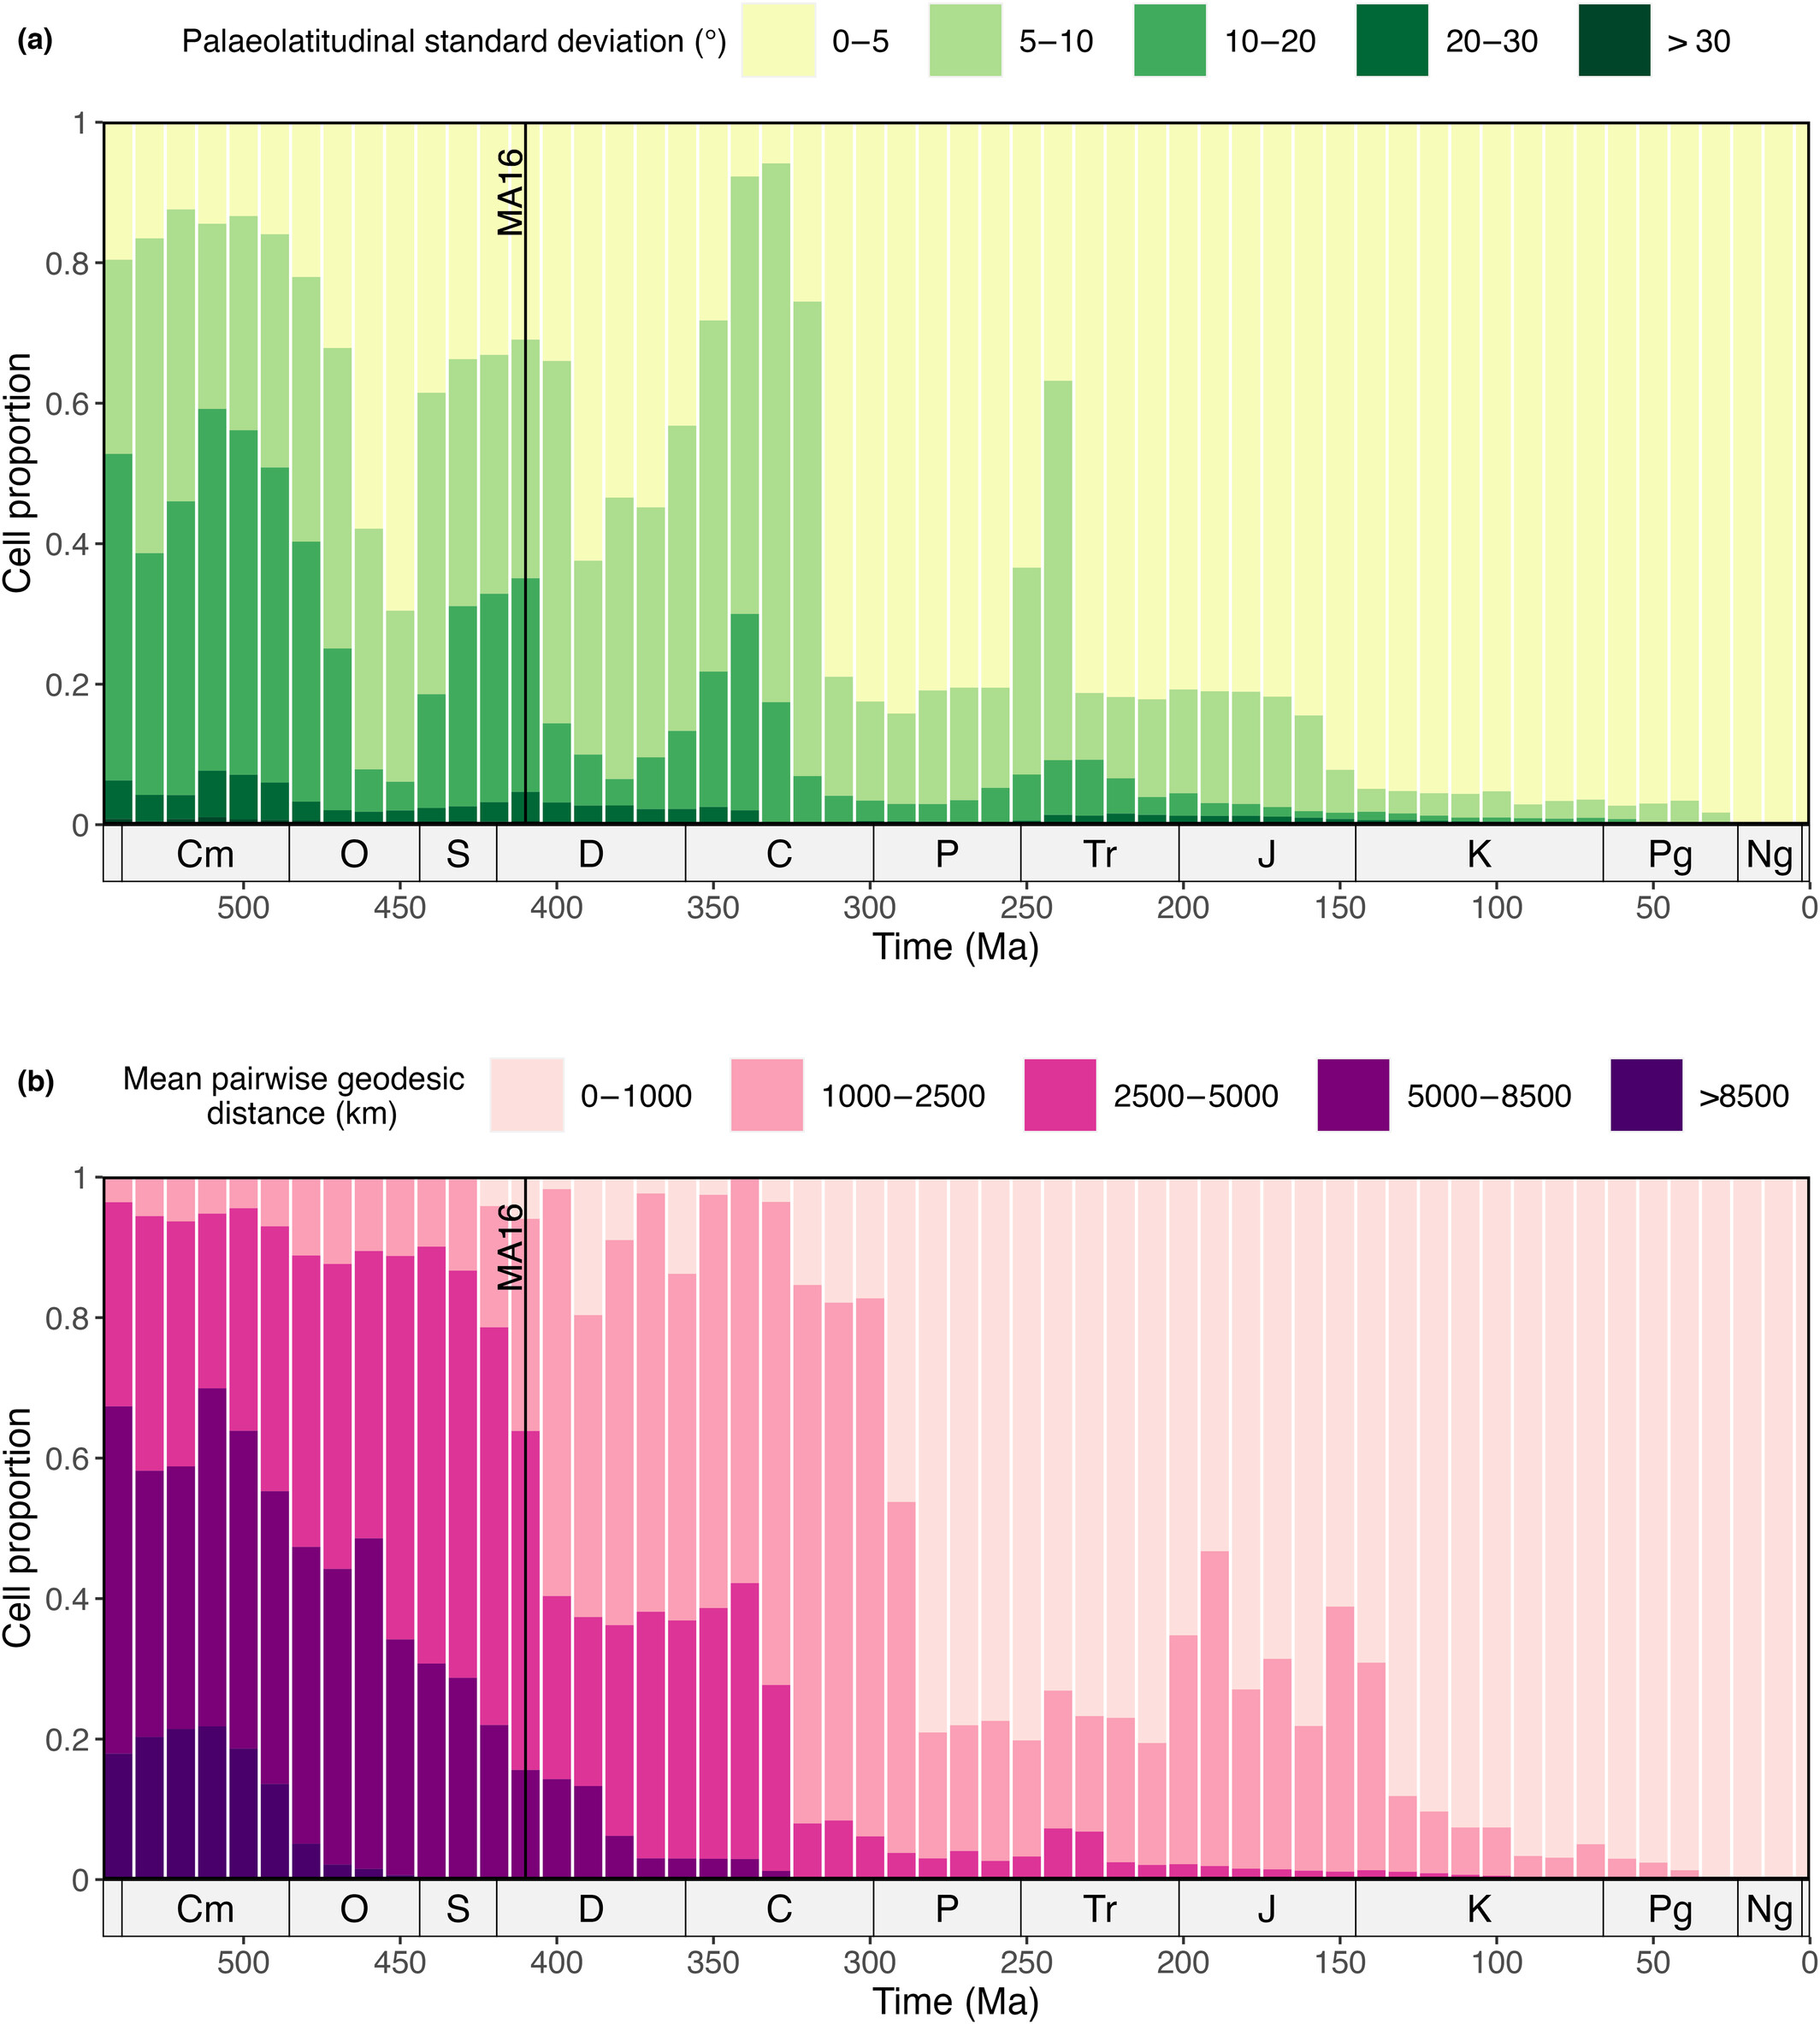
Tower 2
Forward
Compatibility
Buffan et al 2023
Notes:
These decisions lead to increasing differences in the reconstructions as the ‘target ages’ increase.

Slide 39
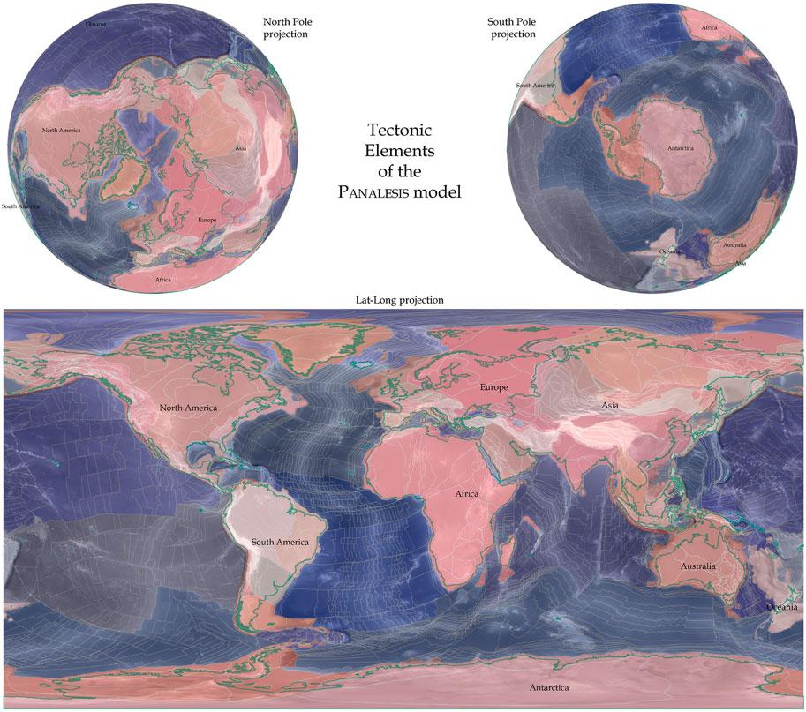
Deformation
Synthetic plates and
Forward
Compatibility
Verard 2021
Notes:
https://doi.org/10.3389/feart.2021.666153 All models start with the modern and work backwards. Consequently, the younger ages are given priority in the models. With in creasing age the oceanic plates are lost to tectonic processes and are replated (if they are) with synthetic plates. Deformation, stretching are not included in any model at this point which is why the modern continental coastlines/terranes (variable depending on scale) are observed even in the oldest reconstructed ages.

Slide 40
R tutorial:
Navigate to: ‘code\2_point_data.R’
https://tinyurl.com/palaeogeography2024palass

Slide 41
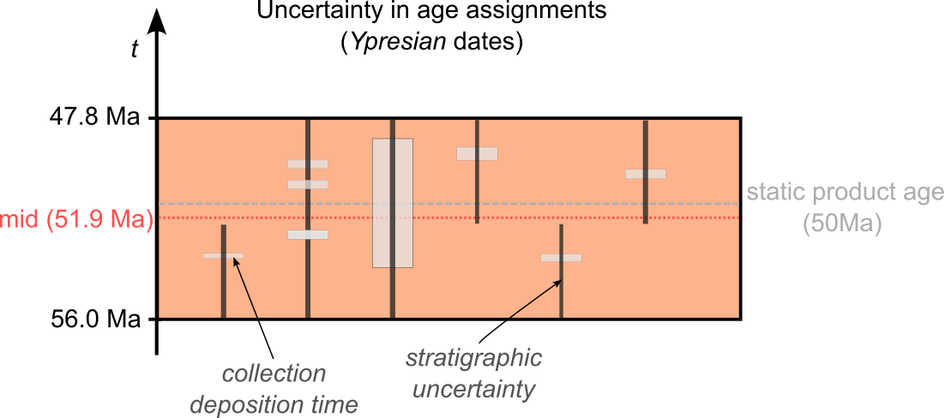
Collections from one time bin were not deposited synchronously!

Slide 42
Break

Slide 43
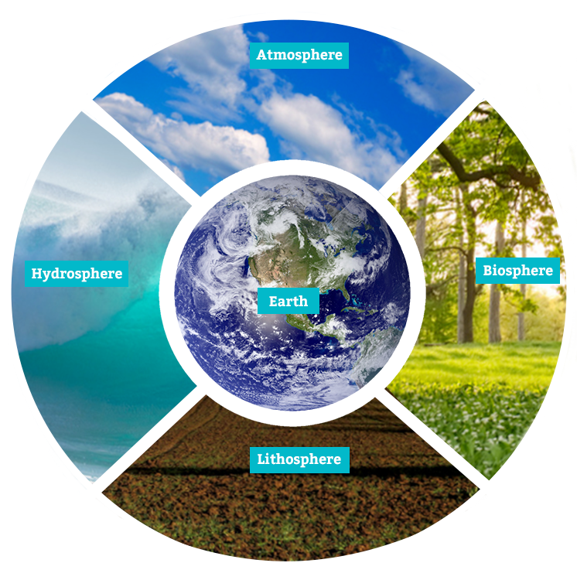
Climate Models and Palaeogeography
Notes:
Image location: https://lsintspl3.wgbh.org/en-us/lesson/buac20-il-whatisfeedback/7?as_guest=True
Introducing dependent layers of Earth.

Slide 44
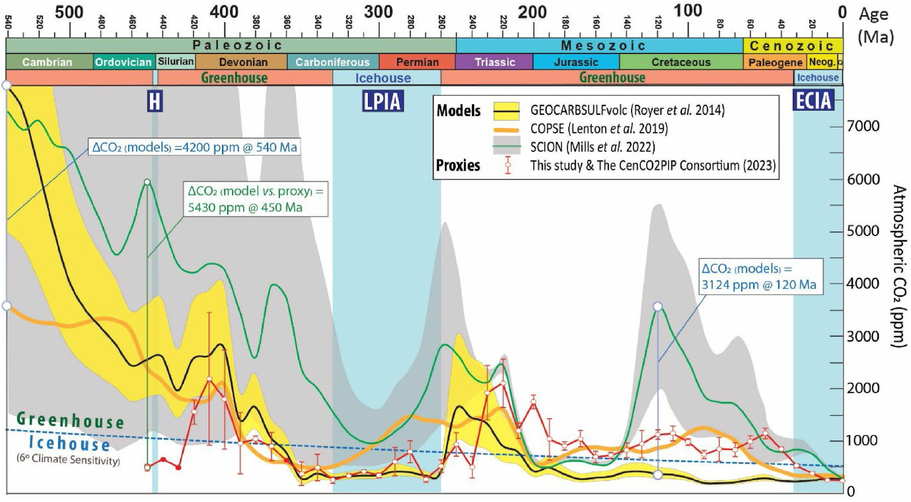
Torsvik et al 2024
Notes:
There are significant changes in the climate models. The climate models are a series of analyses and data treatments that produce climate curves under different assumptions. They rely on degassing, weathering (silicate in particular), and tectonic activity in addition to other data information.

Slide 45
The way you think about a problem will ALWAYS impact the product.

Slide 46
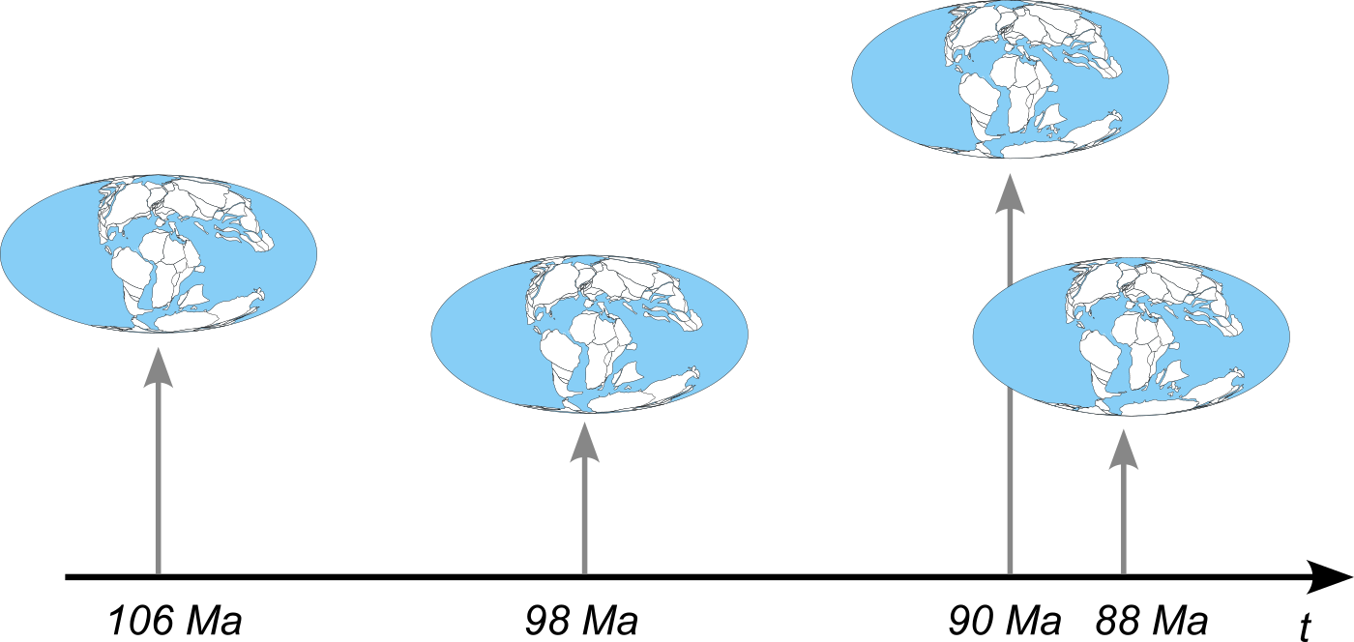
Tectonic models are continuous in time
Notes:
Model reconstructions are available for any point in the past within the model's temporal range.
https://doi.org/10.1016/j.acags.2024.100180

Slide 47
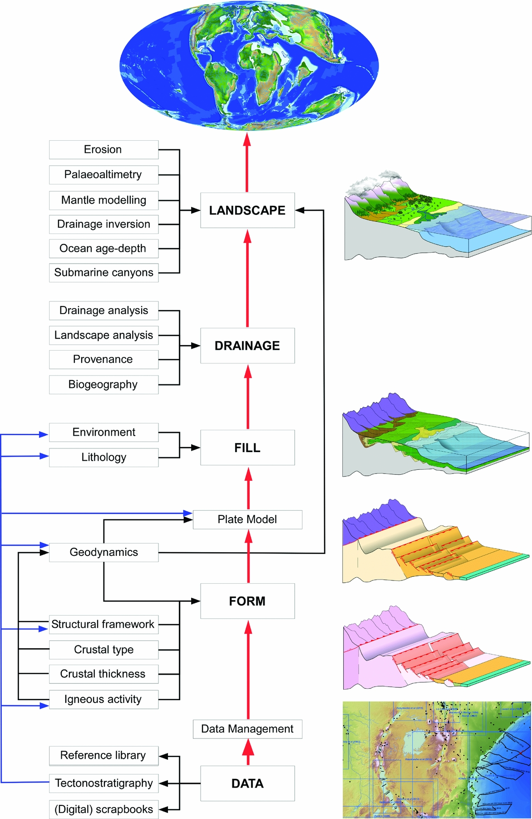
Climate model (plus ocean circulation, precipitation, etc)
Digital Elevation and Palaeogeographic models
Plate model
Notes:
DEMs and everything moving up are derived products from the GPM. The GPM will impact the outcome. MARKWICK, P.J. (2019) ‘Palaeogeography in exploration’, Geological Magazine, 156(2), pp. 366–407. doi:10.1017/S0016756818000468.

Slide 48
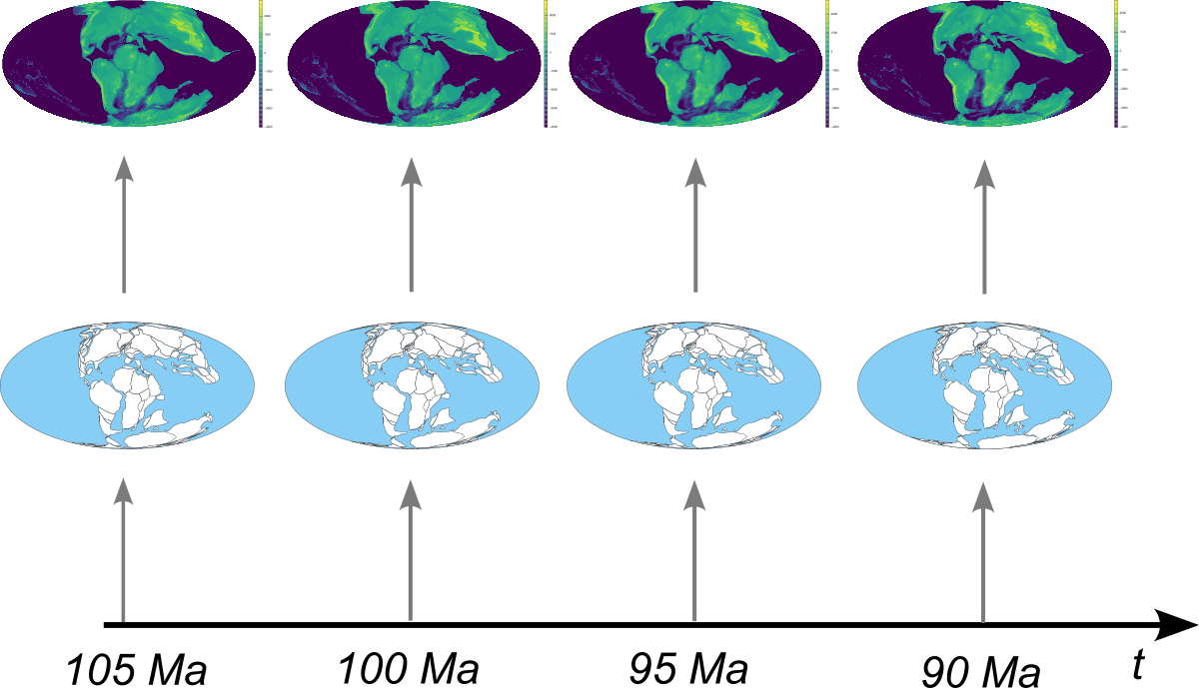
Reconstruction products are bound to specific dates
Notes:
Model reconstructions are available for any point in the past within the model's temporal range.
https://doi.org/10.1016/j.acags.2024.100180

Slide 49
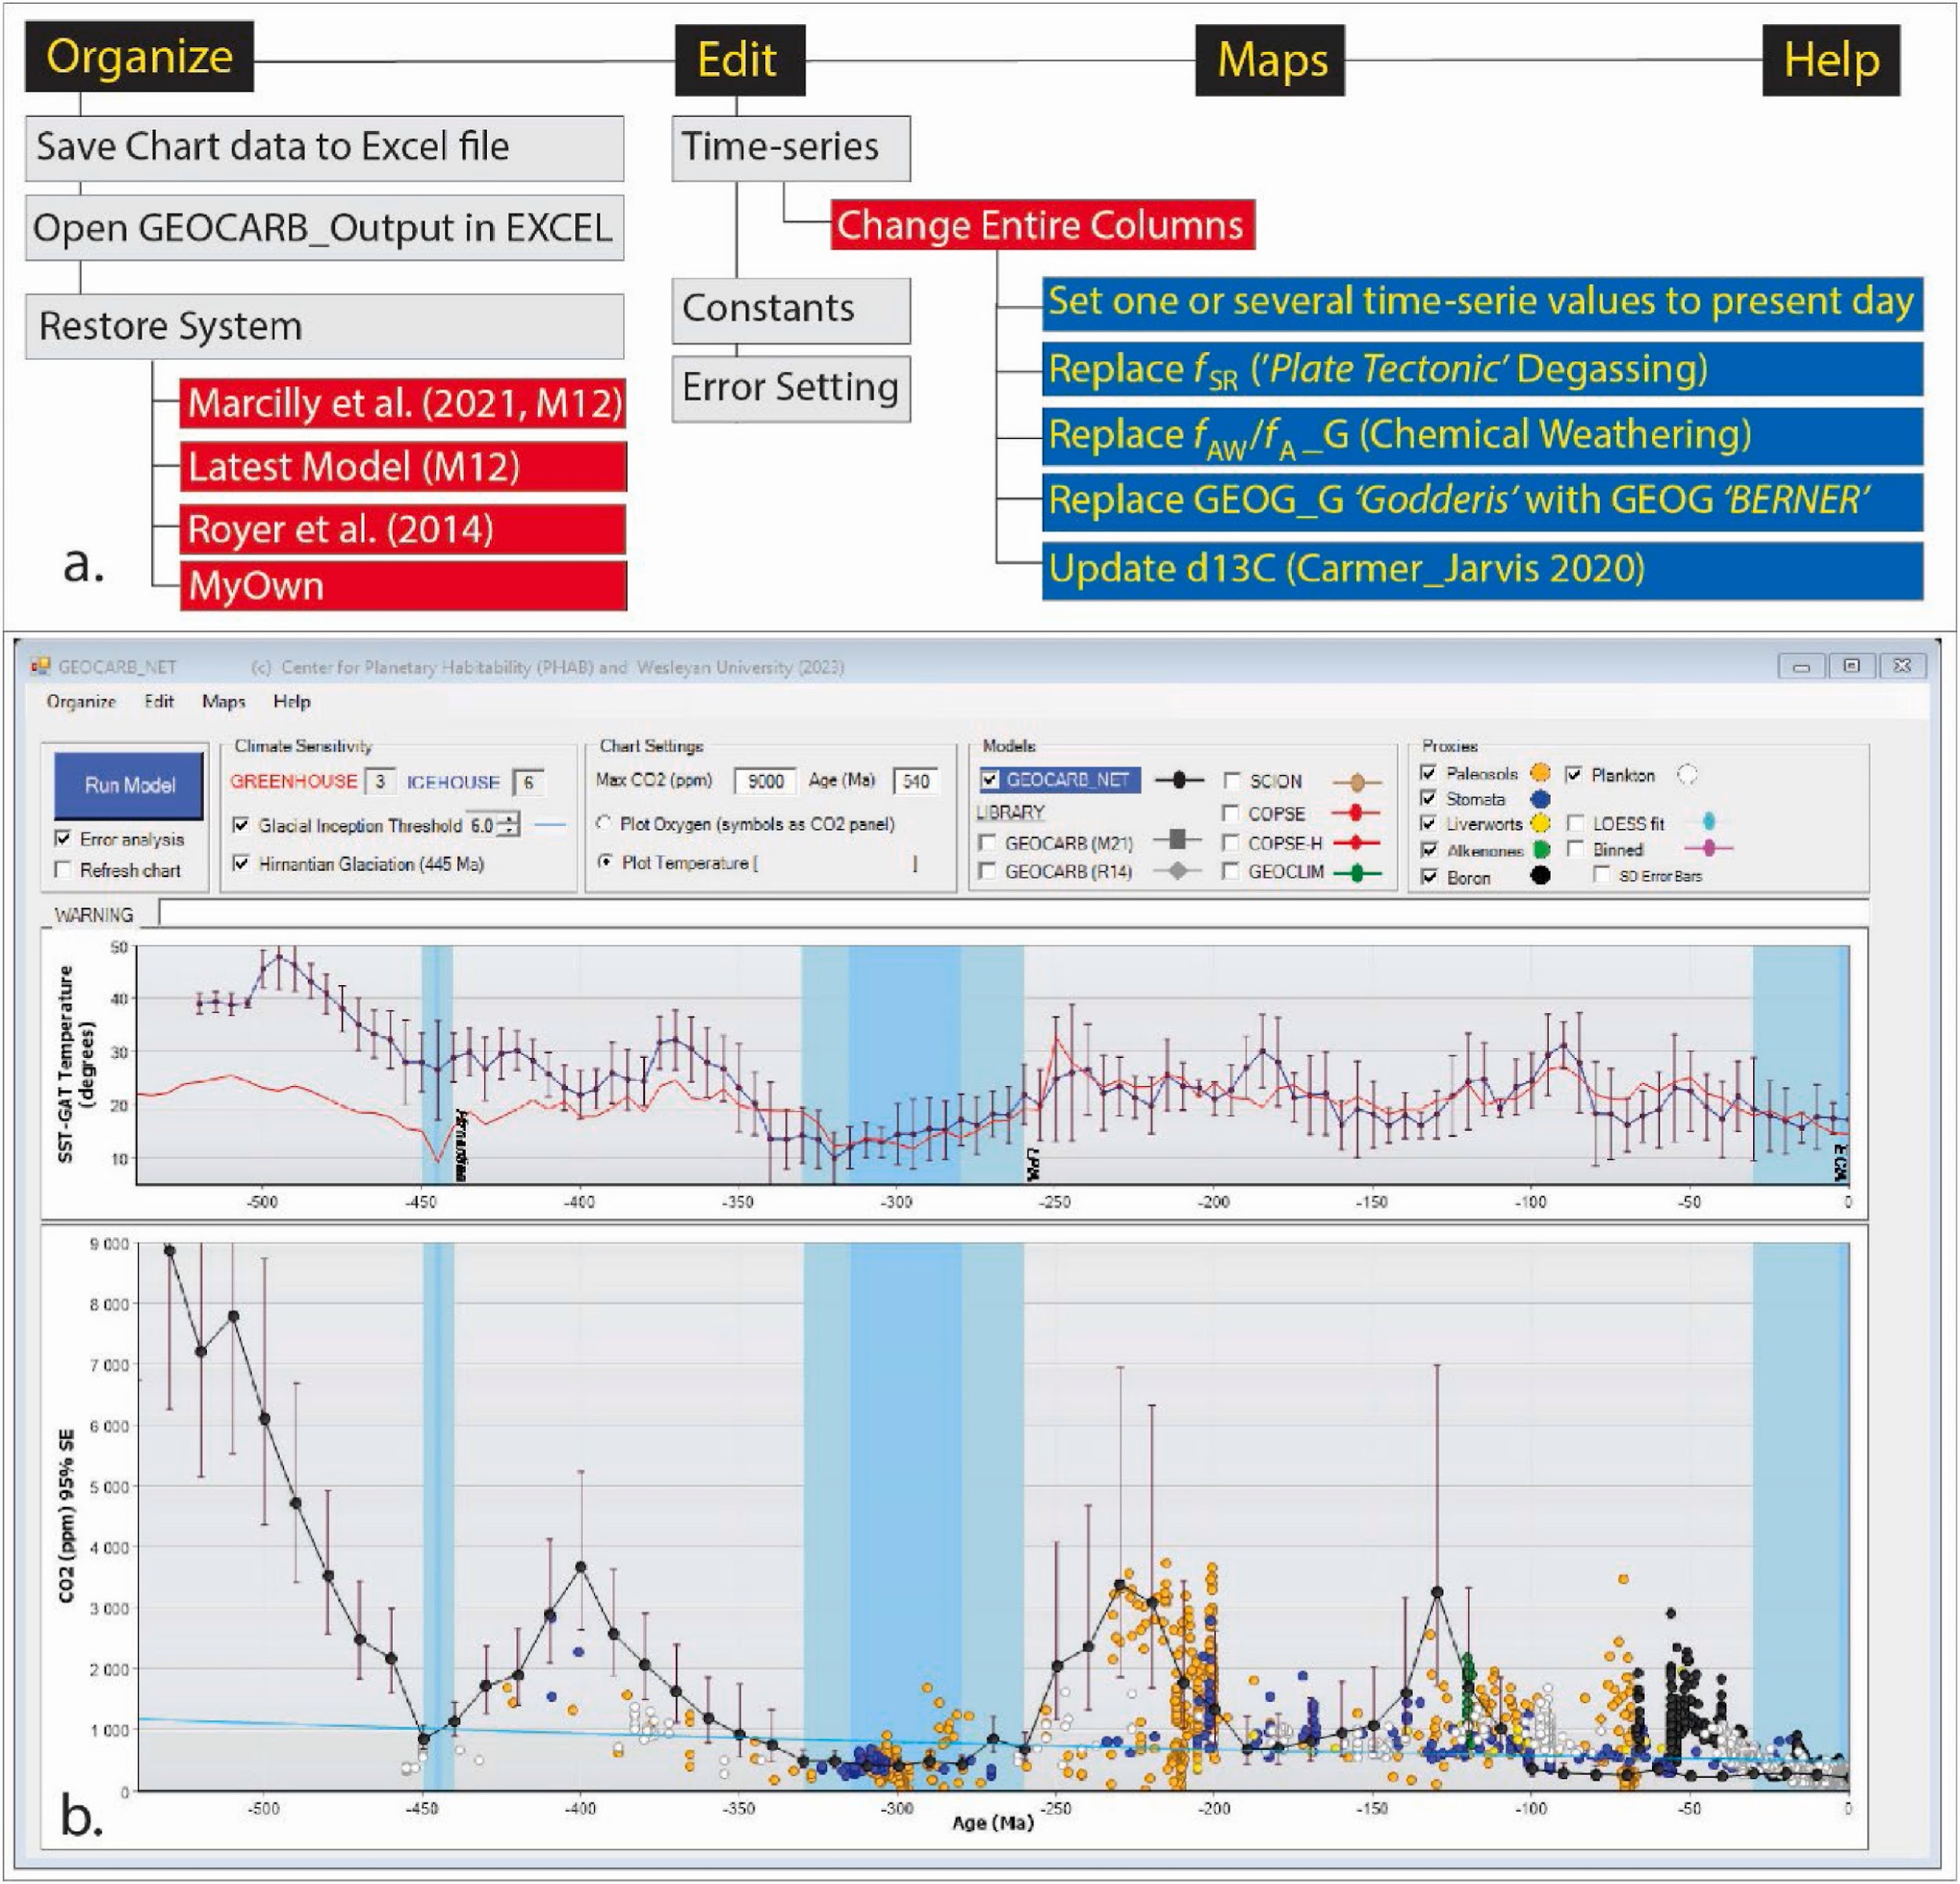
Comparing climate models
Comparing Earths
GEOCARB_NET Torsvik et al, 2024
Notes:
This is an application for comparing climate models under different conditions, and against different base maps.
https://doi.org/10.1016/j.acags.2024.100180

Slide 50
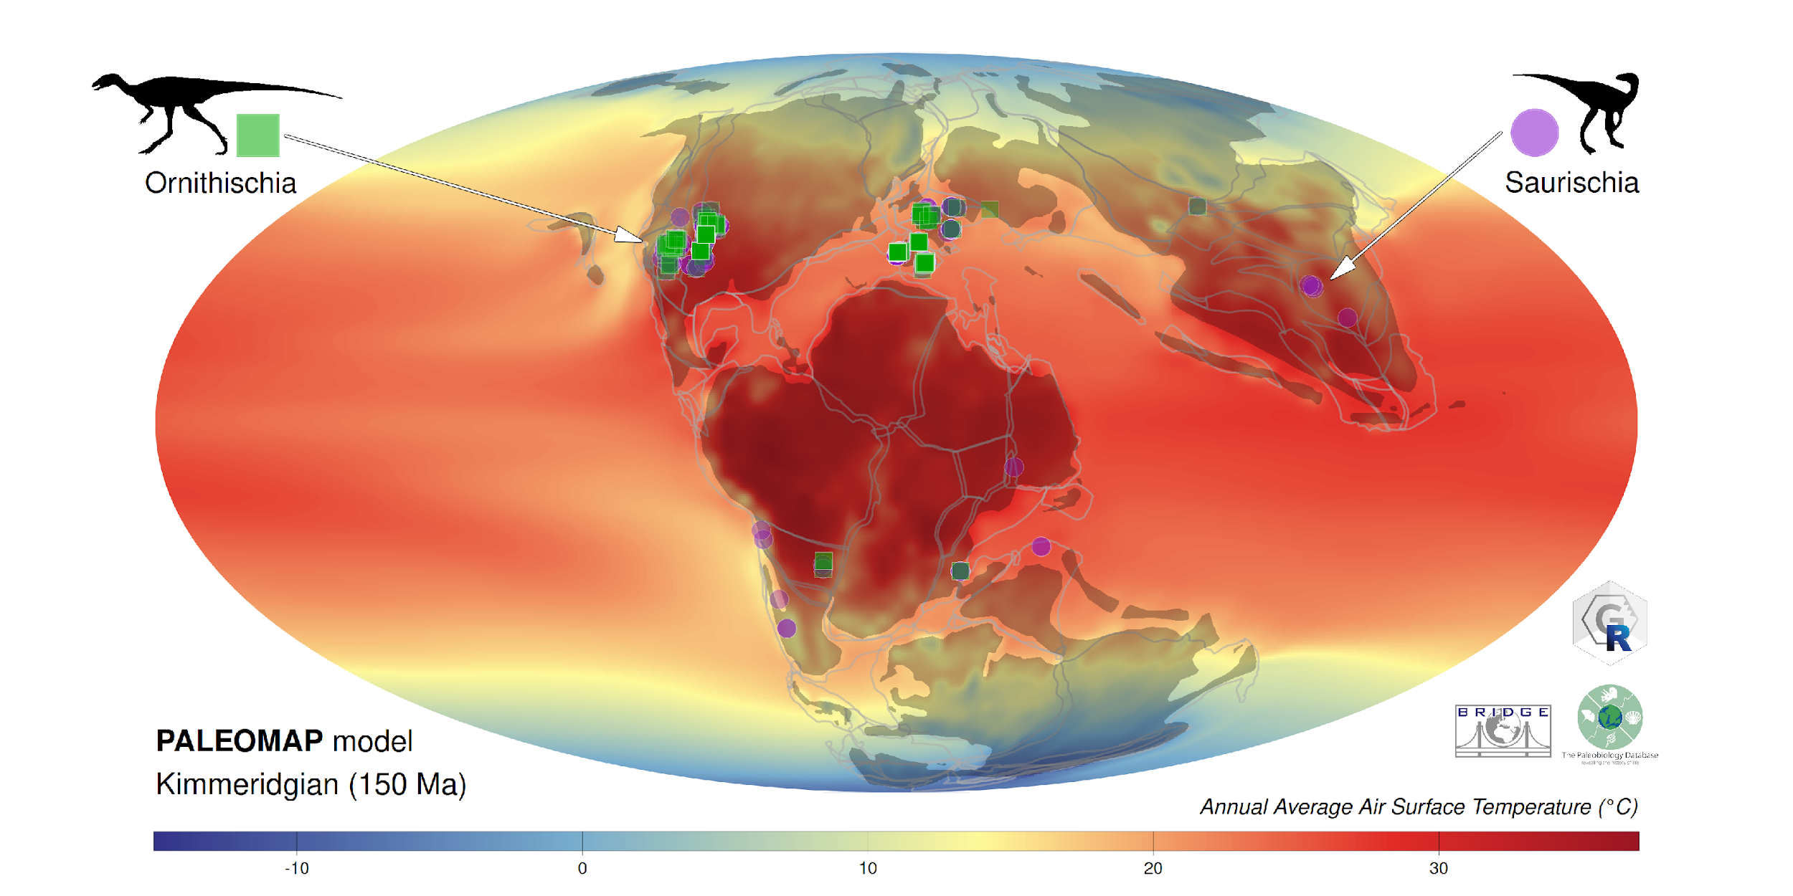
Integrating R libraries and resources

Slide 51
Integrating R libraries and resources
Plate model
Palaeogeographic model
Climate model
Occurrence data
Time data

Slide 52

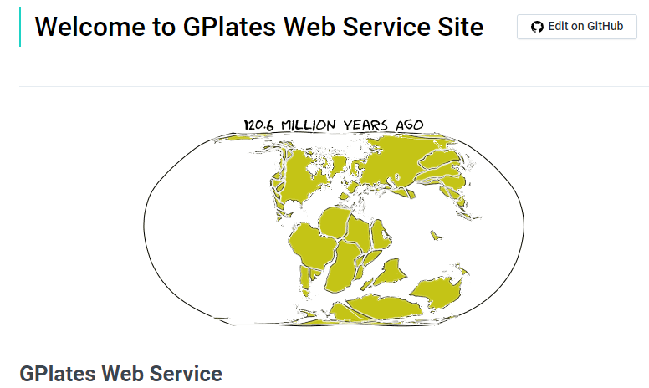
Online
Offline

Slide 53
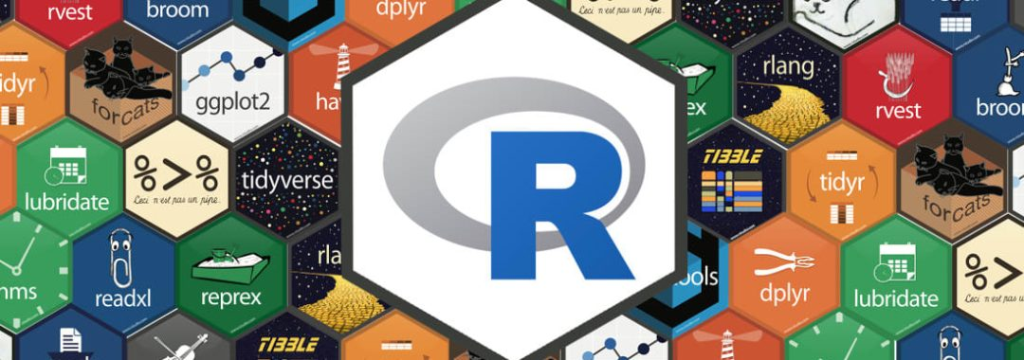



Slide 54
For Windows
C:\Program Files\Gplates\GPlates2.5.0\GeoData\
For Macs
GPlates installed into applications

Slide 55
R tutorial:
Navigate to:
‘code\3_reconstruction_products.R’
https://tinyurl.com/palaeogeography2024palass

